Slide 1
Fixing a Bug with Redirecting Users

Slide 2
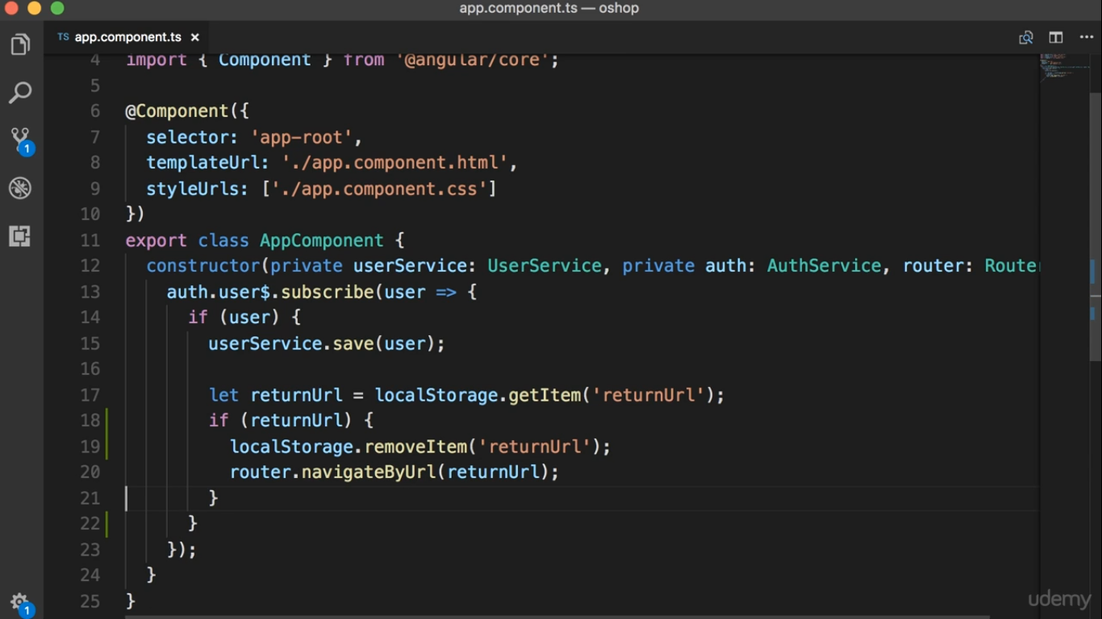

Slide 3
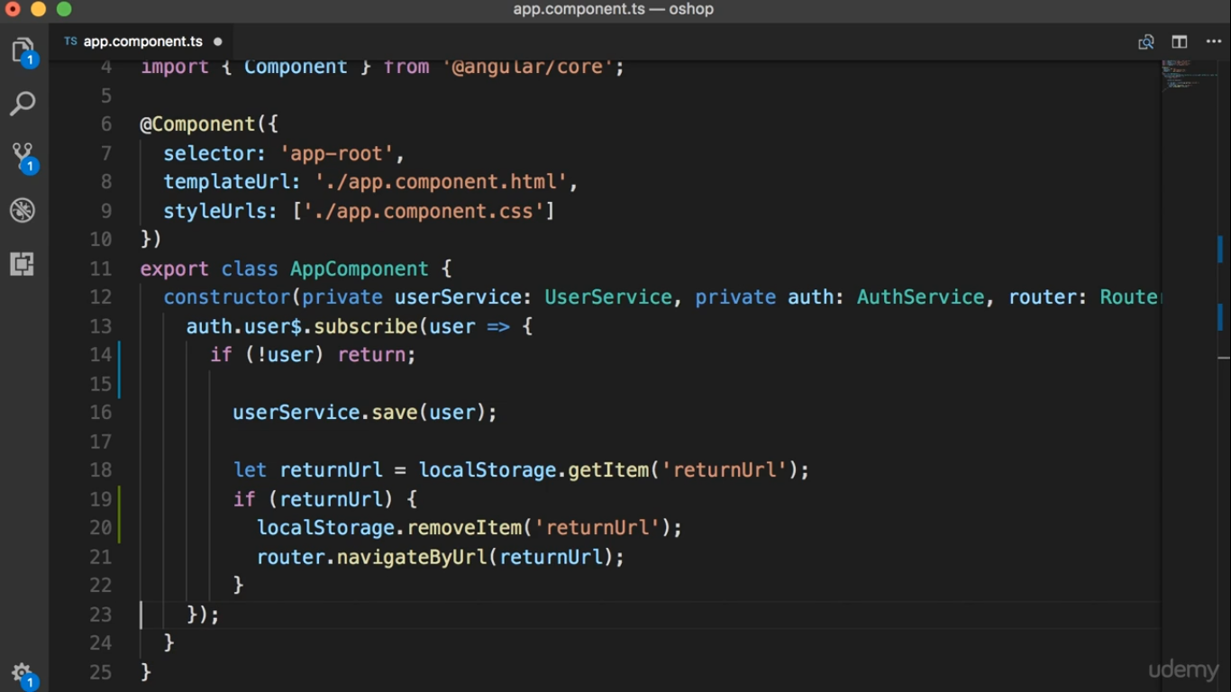

Slide 4
